Slide 1


Intro
IL “Sustainability & Environmental Management” SS 25
Kami Höferl
(Thomson, 1916, PD)

Slide 2

Overview
Recap on Sustainability, Circularity & Global Change
From Principles to Reality
Managing our Way out?
What is Sustainability & Environmental Management?
(Thomson, 1916, PD)
(Escher, 1961)

Slide 3
A Look in the Syllabus

Slide 4
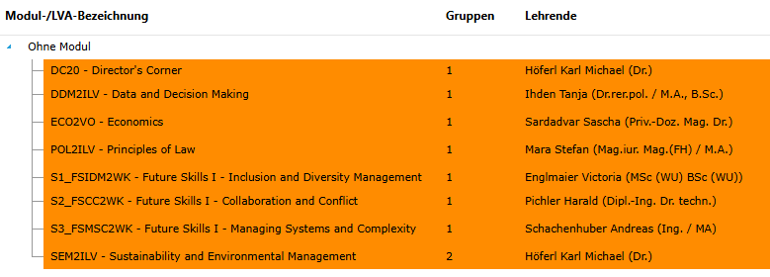
Connected

Slide 5
Looking back …

Slide 6
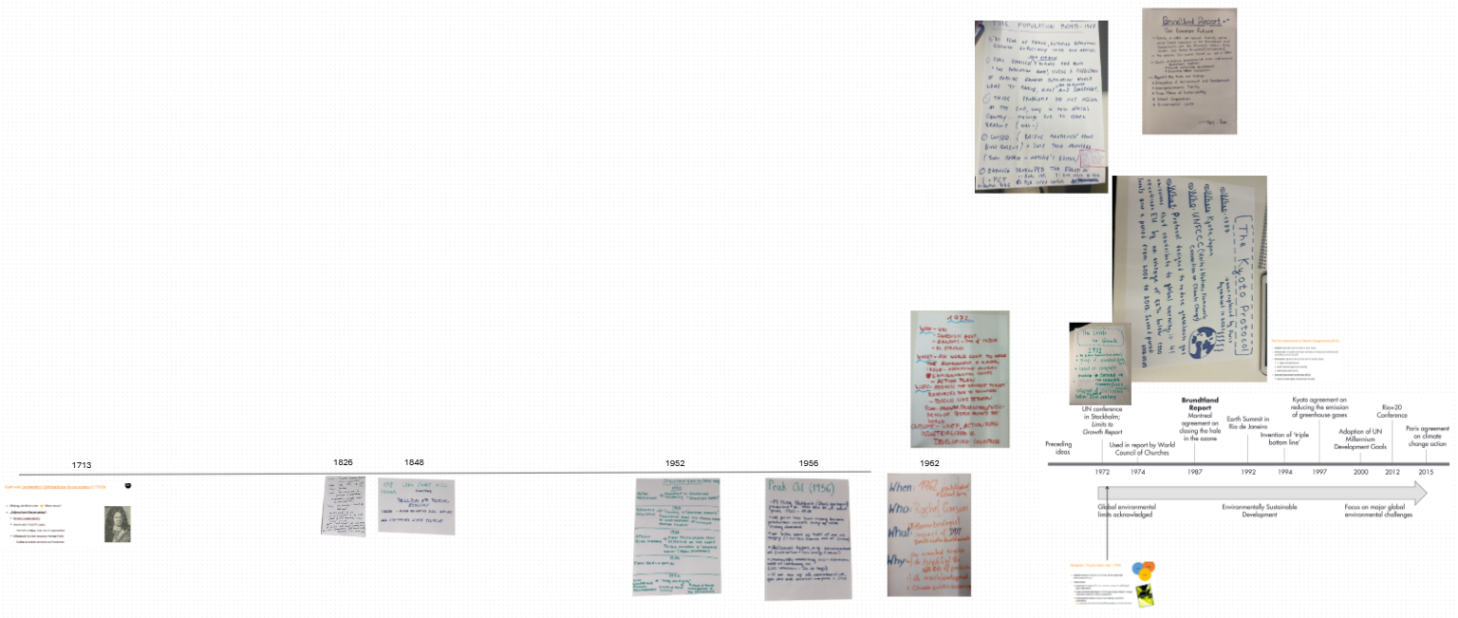
You know, Sustainability!

Slide 7
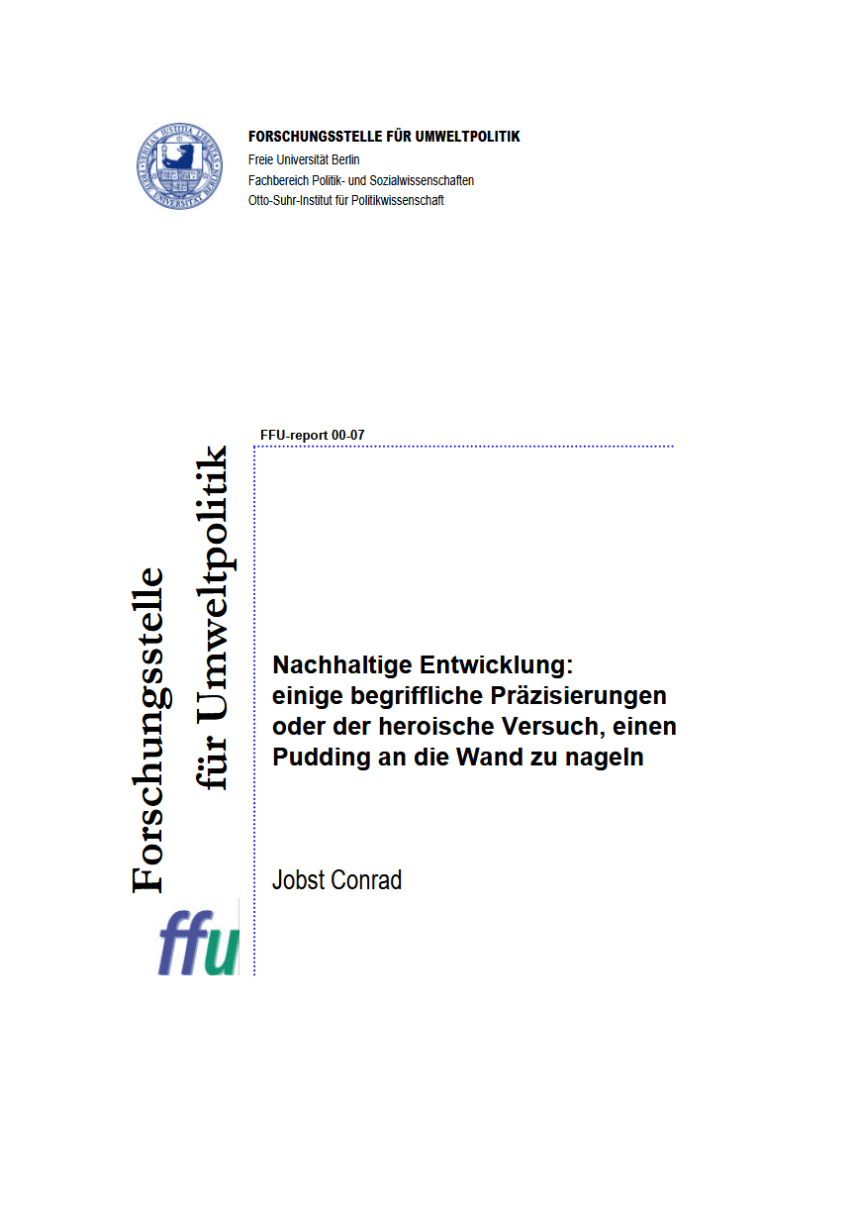
“The” definition of sustainability?

Slide 8

The most iconic definition:
“Humanity has the ability to make development sustainable—to ensure that it meets the needs of the present without compromising the ability of future generations to meet their own needs.” (World Commission on Environment and Development, 1987:8)

Slide 9
The most iconic definition:
“Yet in the end, sustainable development is not a fixed state of harmony, but rather a process of change in which the exploitation of resources, the direction of investments, the orientation of technological development, and institutional change are made consistent with future as well as present needs.” (World Commission on Environment and Development, 1987:9)

Slide 10
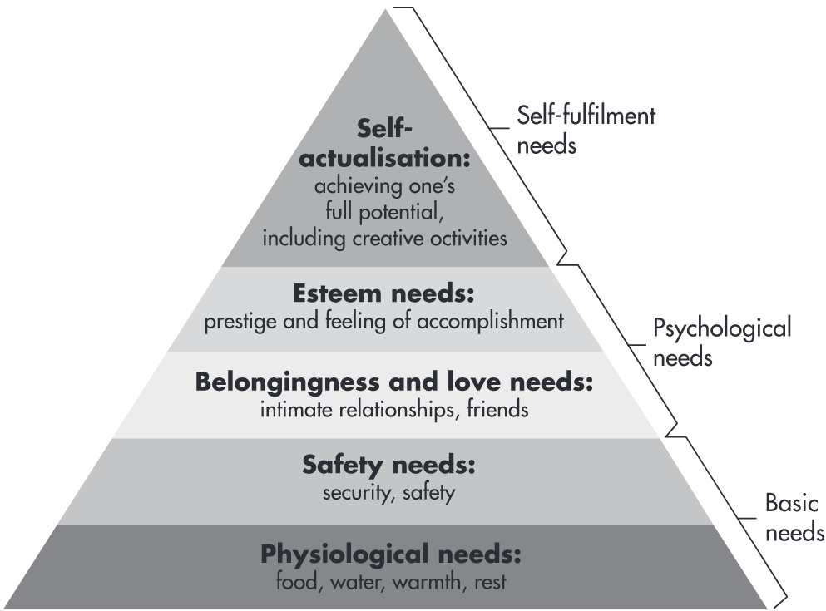



@ Needs?
Maslow's pyramid of needs (1943):
Deficiency needs:
More or less "clear" boundaries
Satisfiable
Growth needs:
No limits "upwards"
👉 not finally satisfiable
Growth needs
Deficiency needs
WLAN
Battery

Slide 11
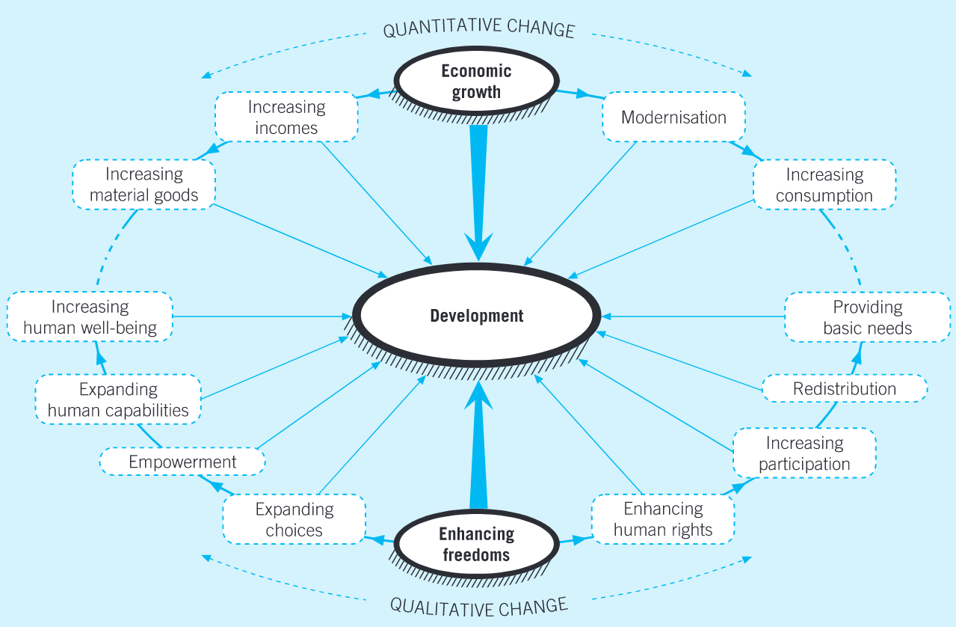
@ What development?
“Development” for:
material consumption through economic growth
human development by improving education, health & living standards

Slide 12
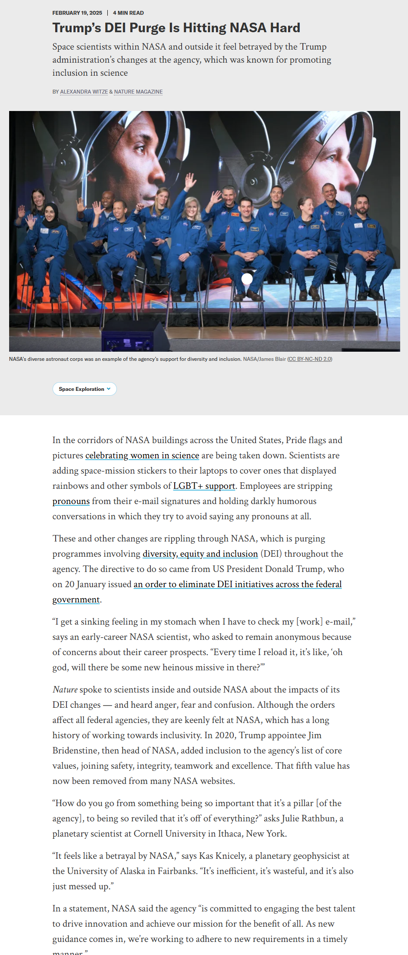
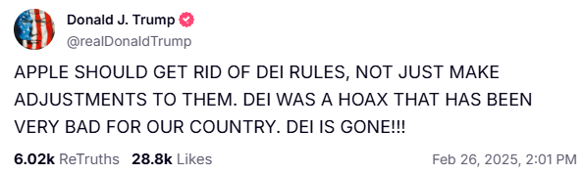
@ What development?
Diversity & inclusion = pillar of sustainable development 👉 INTERgenerational equity

Slide 13
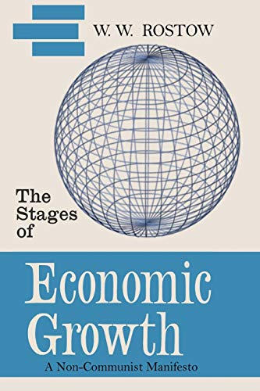
Rostow’s (1960) Stages of Economic Growth
Economic Development = linear Process: Countries pass through distinct stages in a linear progression toward economic maturity & high mass consumption
Industrialization as a key driver: Growth & economic transformation are fueled by industrialization & investment in technology & infrastructure
Investment & Innovation: Economic take-off requires significant investment in technology, education & infrastructure to support productivity & innovation
Role of Consumption in Mature Economies: Advanced stages are marked by high levels of consumer spending, shift towards service industries, reflecting improved living standards
Model for Economic Planning: Provides a roadmap for countries looking to advance economically, highlighting the need for strategic investment & policy interventions

Slide 14
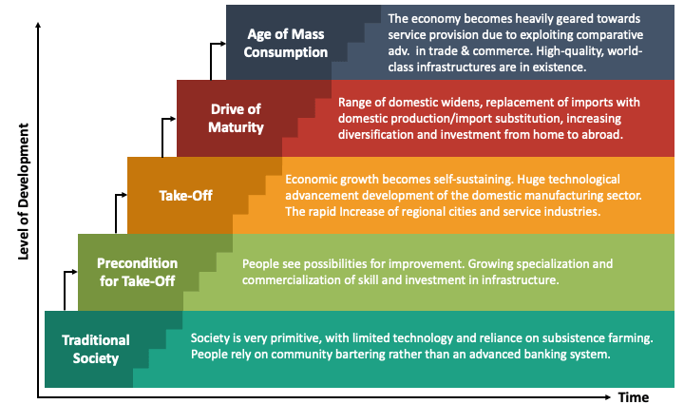
Rostow's Stages of Economic Growth
Notes:
The Five Stages:
Traditional Society:
Characterized by subsistence agriculture & limited technology.
Social structures are rigid, with little emphasis on economic growth.
Pre-Conditions for Take-Off:
Emergence of new industries & infrastructure development (e.g., transportation, communication).
Increase in investment, particularly in technology & education.
Shift from agriculture to manufacturing begins.
Take-Off:
Rapid industrialization, with significant technological advancements.
Growth in productivity & urbanization.
Emergence of key industries that drive economic growth (e.g., textiles, railways).
Drive to Maturity:
Diversification of the economy, with more complex industries (e.g., heavy industry, chemicals).
Investment in social infrastructure (education, healthcare) & technological innovation.
Increase in national income & a higher st&ard of living.
Age of High Mass Consumption:
Shift towards a consumer-oriented economy, with focus on services & high-quality goods.
Increased income leads to widespread access to goods & services.
Welfare state & social programs become prominent.

Slide 15
Earth-Systems Perspective?
Holistic approach: Earth = interconnected system
atmosphere, hydrosphere, biosphere, lithosphere, anthroposphere
Dynamic interactions:
processes, feedback loops, and thresholds influencing system stability
positive (amplifying) and negative (stabilising) feedbacks
Planetary boundaries: safe operating limits for Earth’s systems
climate, biodiversity, etc.
Temporal and spatial scales
processes from local to global and short to geological timescales
Interdisciplinarity: insights from natural and social sciences to understand complex interactions
Human Role: humans = dominant geological force 👉 Anthropocene
Focus on resilience: system capacity to absorb disturbances and adapt to change

Slide 16
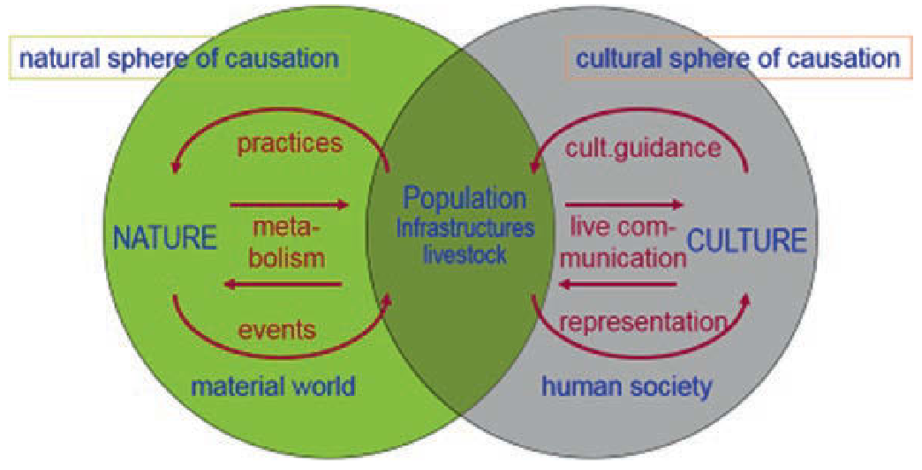
Understanding society as hybrid system (e.g. Fischer-Kowalski and Weisz 1999)

Slide 17
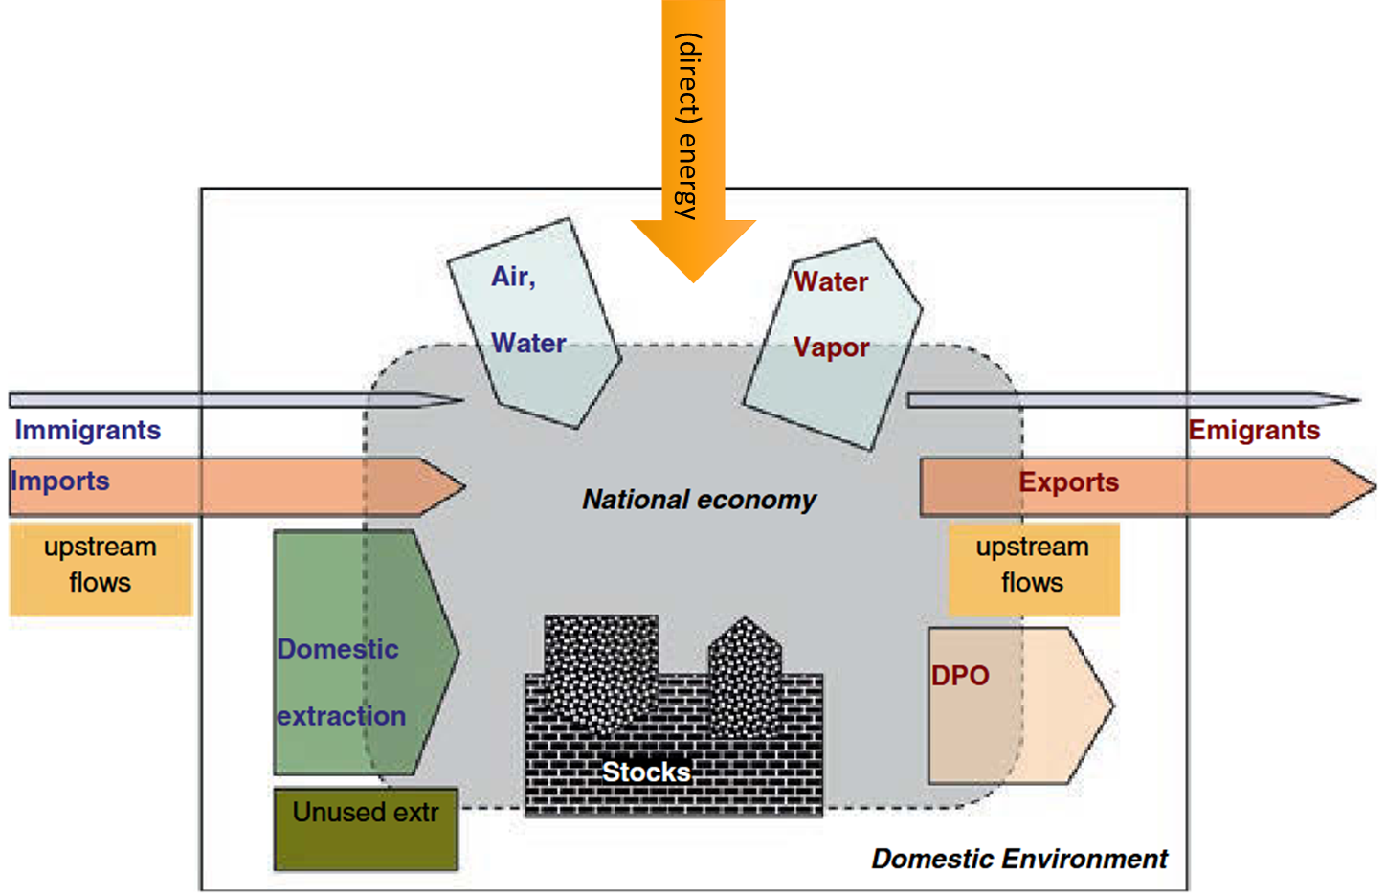
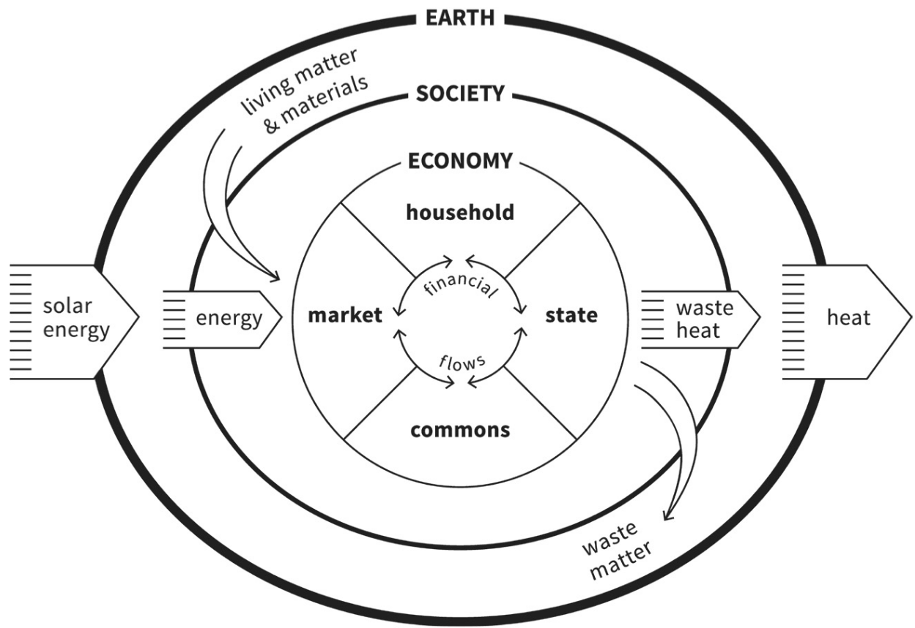
To sum it up: We’ve come a long way

Slide 18
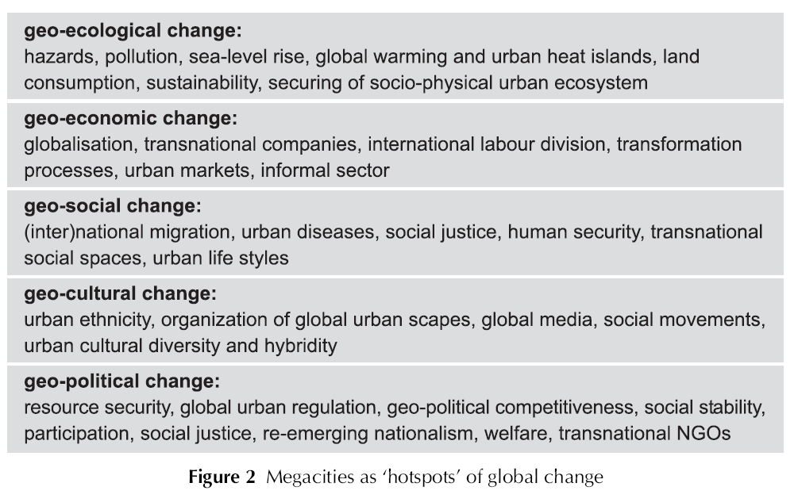
But what exactly is Global Change?
large-scale transformations affecting the Earth’s systems, including environmental, economic, social, and political shifts:

Slide 19
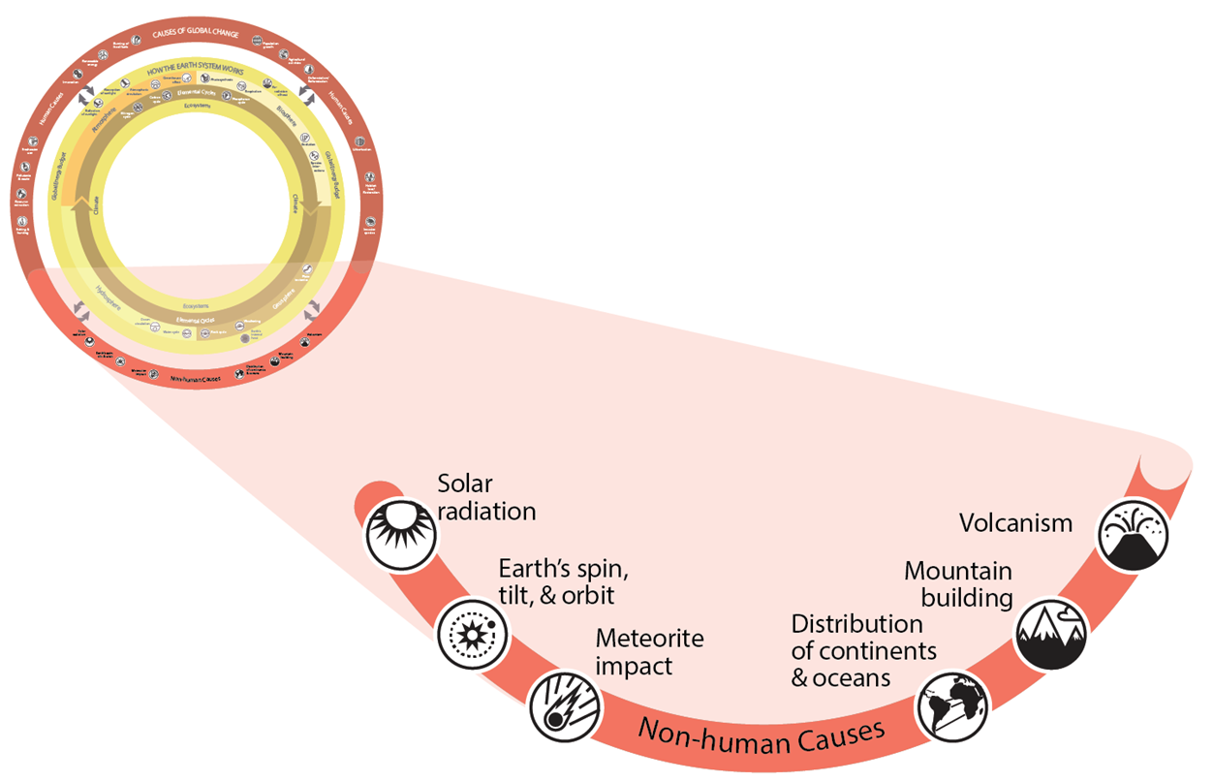
Non-human causes

Slide 20
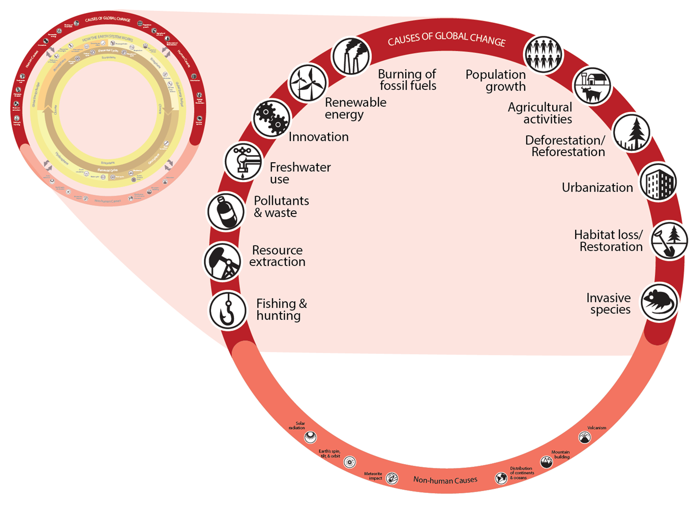
Human causes

Slide 21
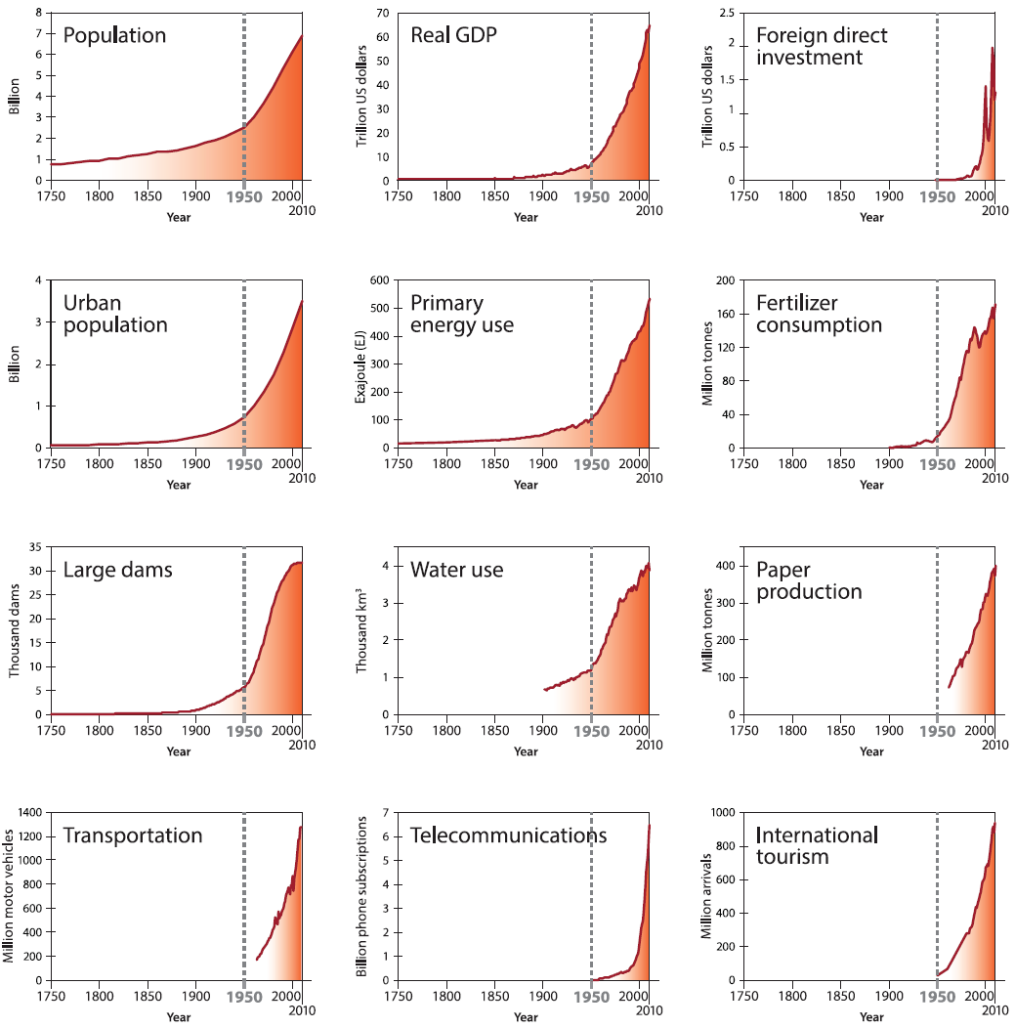
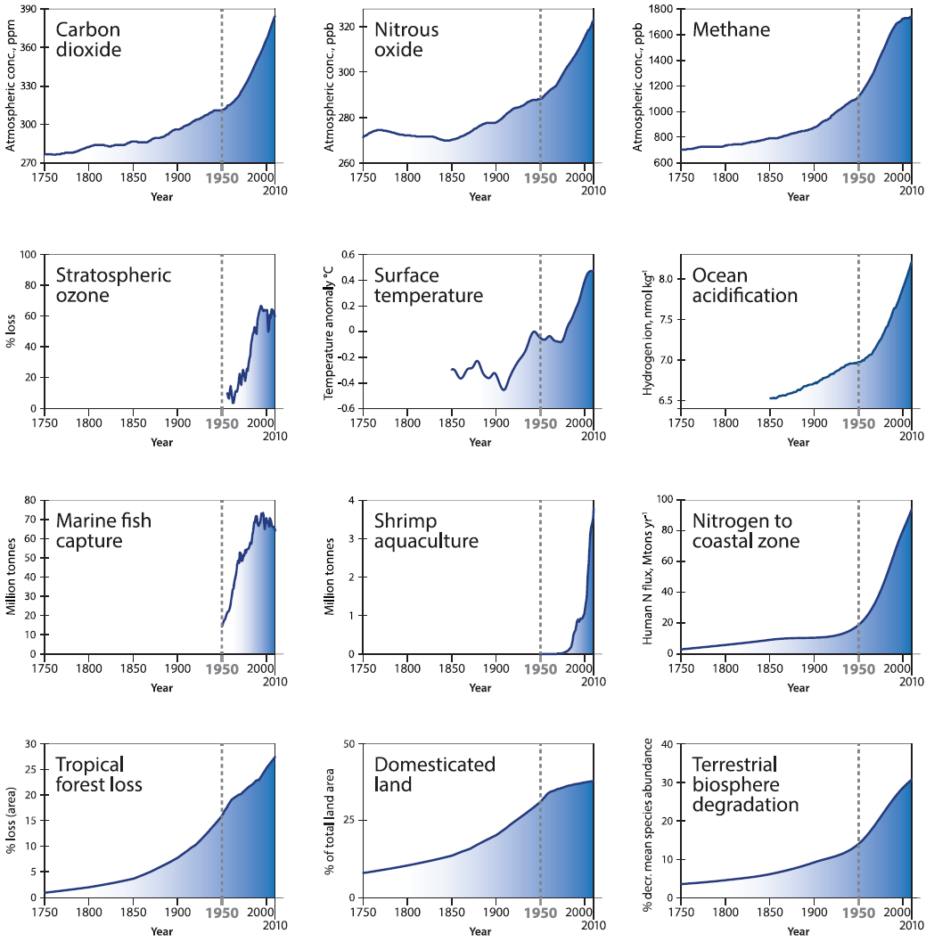
Great Acceleration: Steffen et al. (2015)

Slide 22
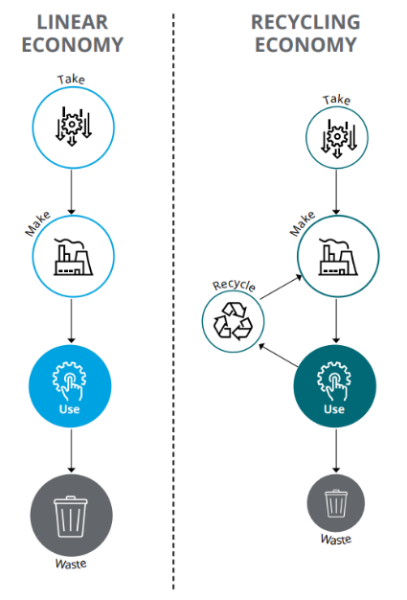
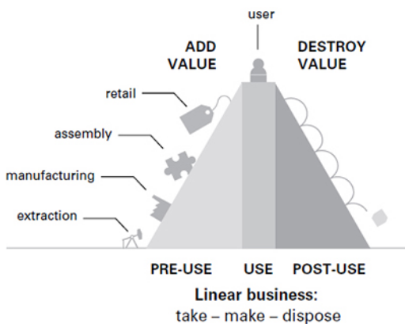
A conclusion: Dominant linear model

Slide 23
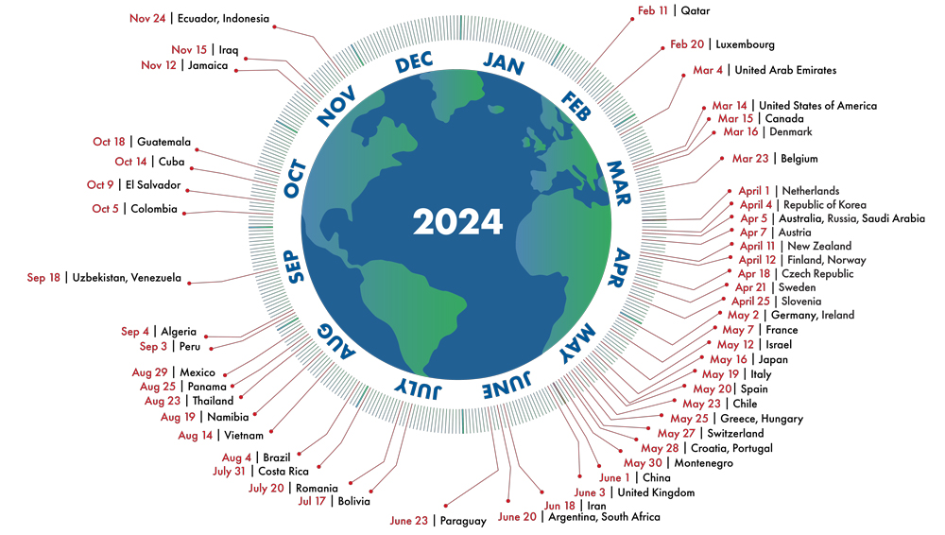
Our national Overshoot Days

Slide 24
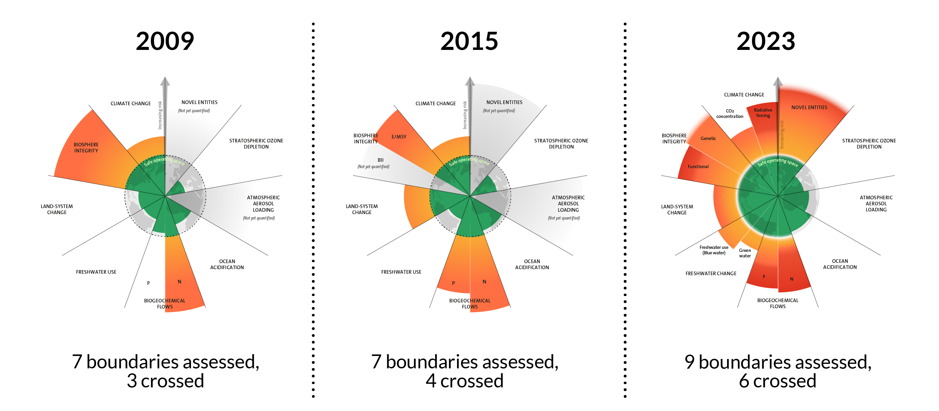
Reviewing our performance so far
(Azote for Stockholm Resilience Centre, based on analysis in Richardson et al 2023; CC BY-NC-ND)

Slide 25
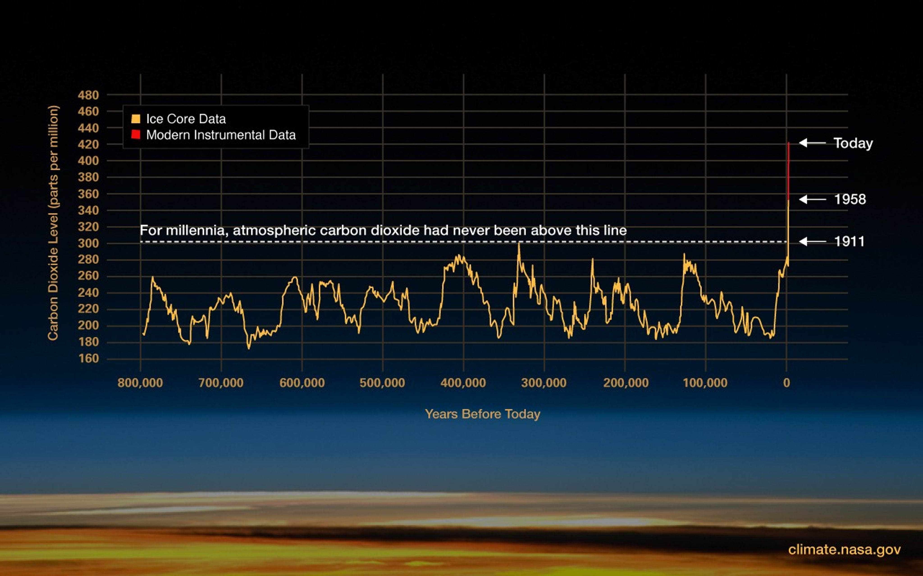
Climate Change – but how?

Slide 26
Where is the Problem?

Slide 27
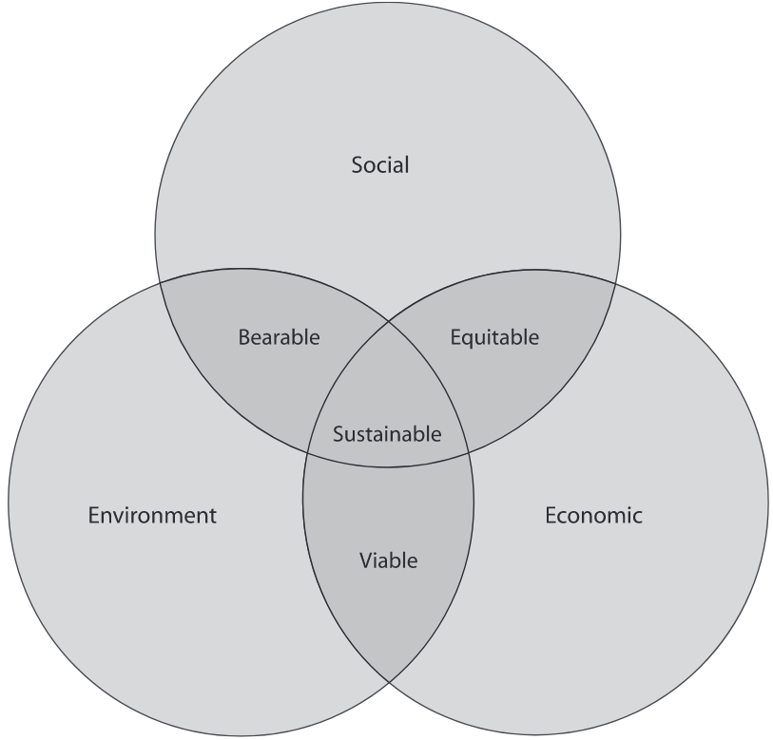
Elkington’s “Tripple Bottom Line” (1994)

Slide 28
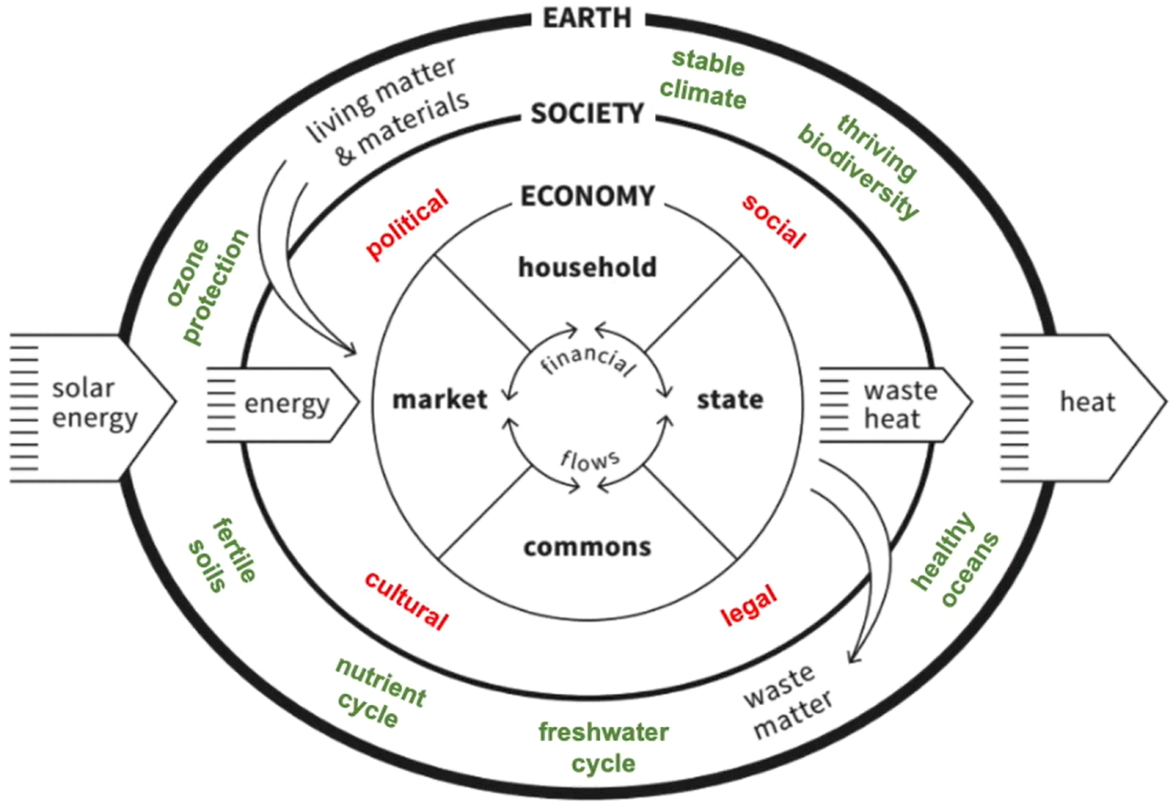
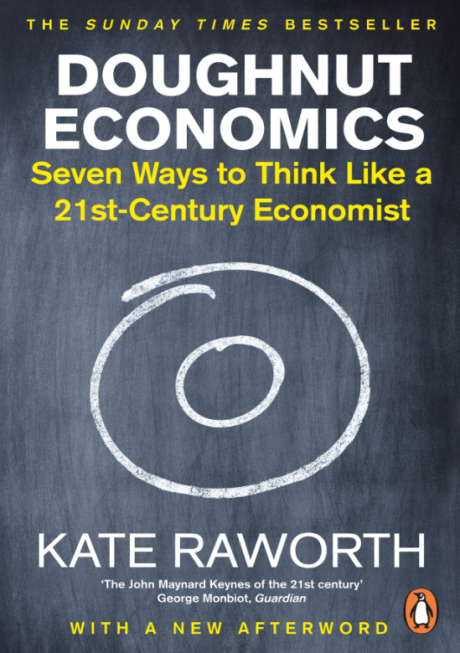
To sum it up: We’ve come a long way

Slide 29
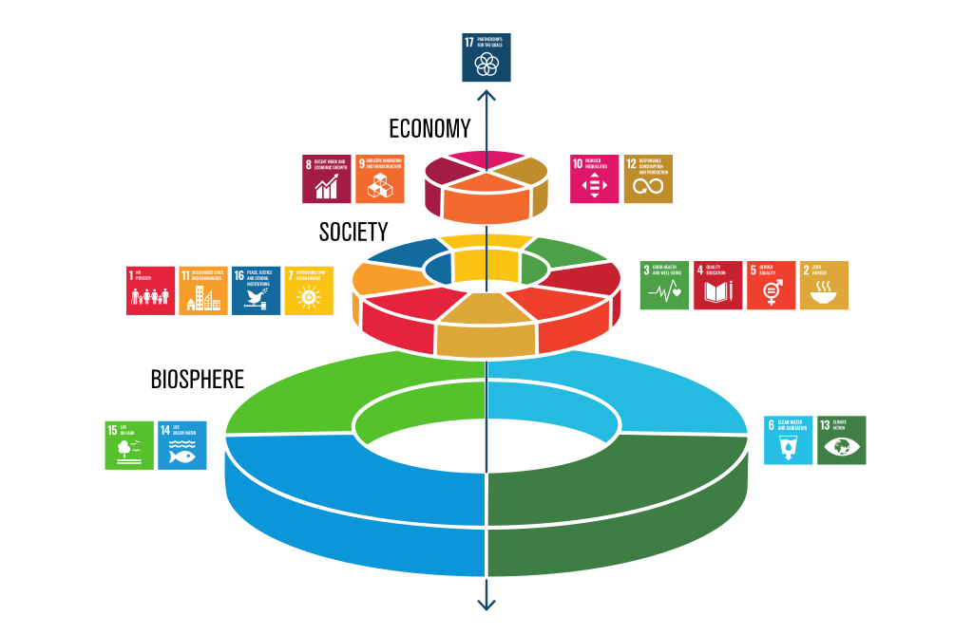
SDG structured

Slide 30
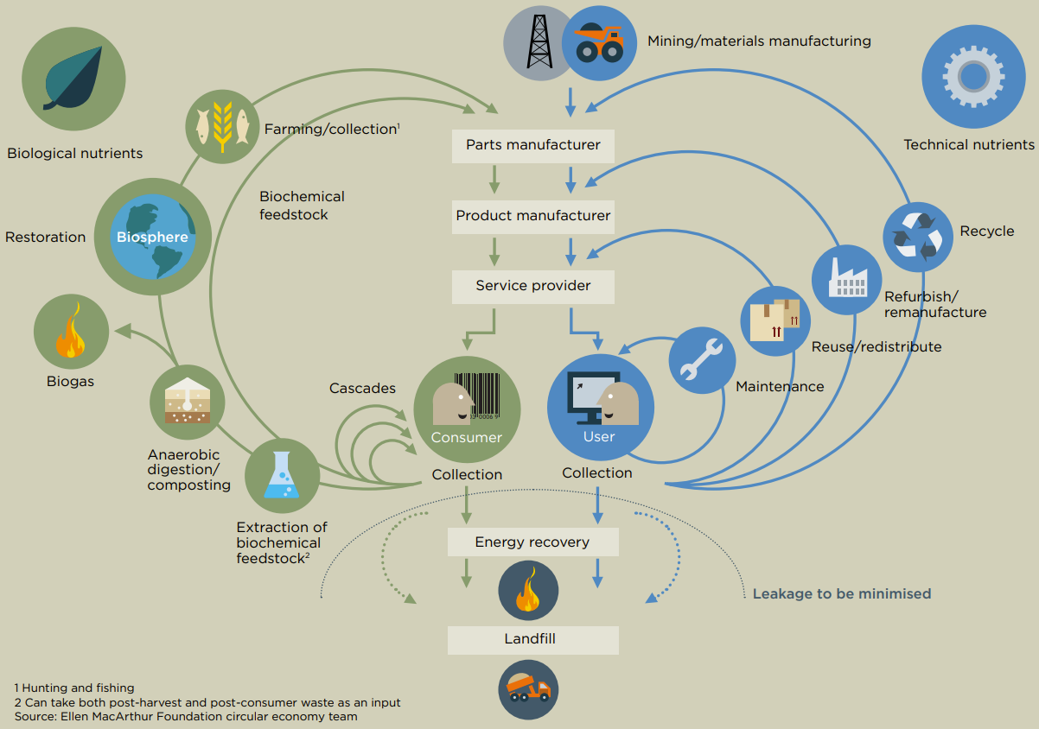

The iconic “Butterfly Diagram”:
Notes:
Linear: Take – make – waste
80% environmental impact from insufficient design (EC, 2020:3)
Walter Stahel: 1982 „closed loop economy“
2013: Ellen MacArthur Foundation Vol. 1
3R: 2008 Circular Economy Promotion Law of the People’s Republic of China
MacArthur:
Eliminate waste and pollution
Circulate products and materials (at their highest value)
Regenerate Nature

Slide 31
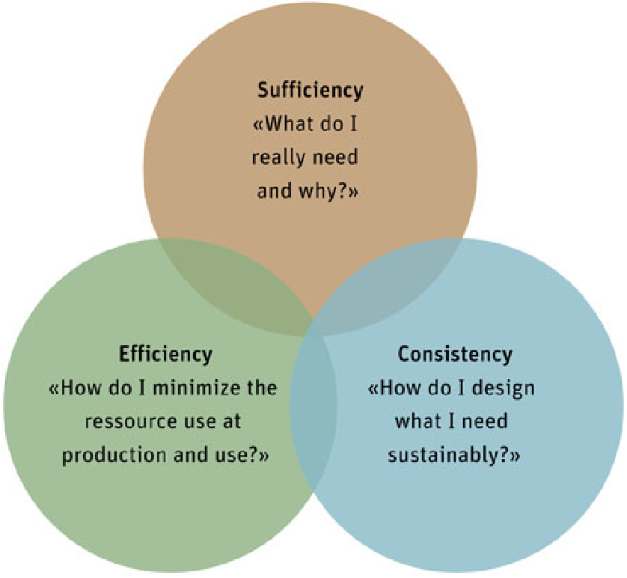
Three common strategies

Slide 32
1. Efficiency
Key Idea: Do more with less
Goal: Minimise resource use & waste while maintaining productivity
Strategies:
Energy Efficiency: energy-saving technologies & processes
Material Optimisation: Reduce material inputs & waste generation
Process Improvement: Streamline operations 👉 enhance resource efficiency
Technological Innovation: solutions to improve resource utilisation
Focus: Reduce environmental impact without compromising functionality or output

Slide 33
2. Sufficiency
Key Idea: reduce consumption to sustainable levels
Goal: Achieve long-term sustainability by addressing overconsumption
Strategies:
Reduce Demand: Encourage mindful consumption & avoid excess
Promote Sharing: collaborative use of resources (tool libraries, car-sharing, etc.)
Extend Product Life: Repair, reuse, and upcycle 👉 maximise utility
Encourage Simplicity: minimalism & sustainable lifestyles
Focus: Shift behaviours 👉 reduce environmental pressure & resource depletion.

Slide 34
3. Consistency
Key Idea: Align activities with natural systems and cycles
Goal: processes & products = environmentally harmonious
Strategies:
Renewable Energy: Use sustainable energy sources
Closed-Loop Systems: Design for recyclability & reuse
Eco-Friendly Materials: non-toxic, biodegradable, or renewable materials
Planetary Boundaries: Operate within environmental limits 👉 long-term balance
Focus: Foster systems that work with, not against, nature.

Slide 35
Some key concepts & principles:
Mulligan’s (2018:10) Principles:
Acknowledge interconnections at all levels within the biosphere.
Acknowledge that there are limits to growth.
Remember that prevention is better than cure.
Work to improve intra-generational equity.
Face up to the challenges of intergenerational equity.
Respect requisite diversity in both nature and culture.
Work for relocalisation with global connectedness.
Move from consumerism to quality-of-life goals.
Learn how to travel hopefully in a world of uncertainty.
Dresner’s (2002: 73) Key Concepts:
“needs”:
Priority on essential needs of the world’s poor
“limitations”:
imposed by the state of technology and social organization on the environment’s ability to meet present and future needs.

Slide 36
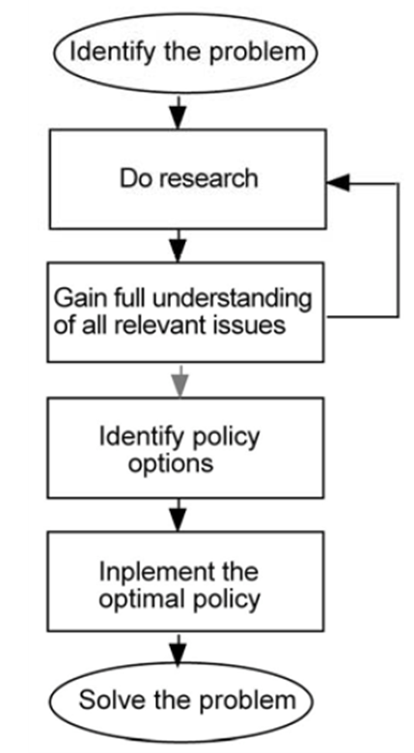
In the End: Simply apply these Principles!
👉 rational model of planning & management

Slide 37
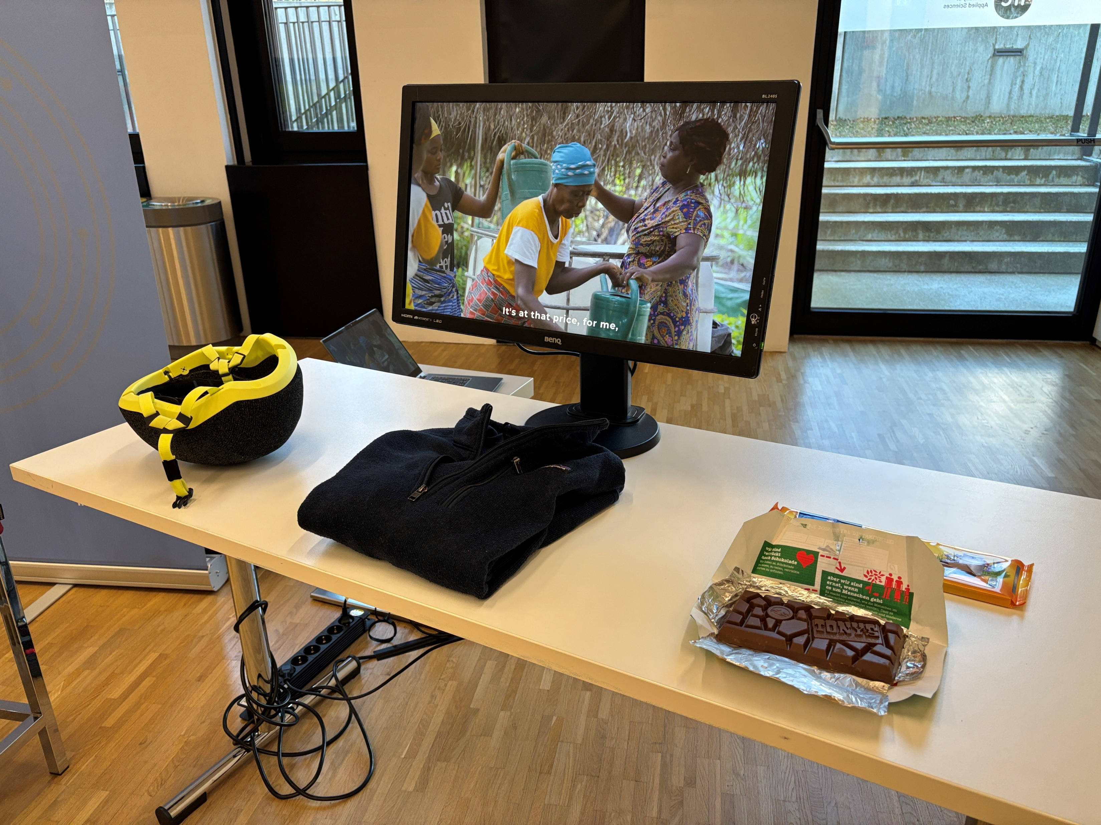
In the End: Simply apply these Principles!

Slide 38
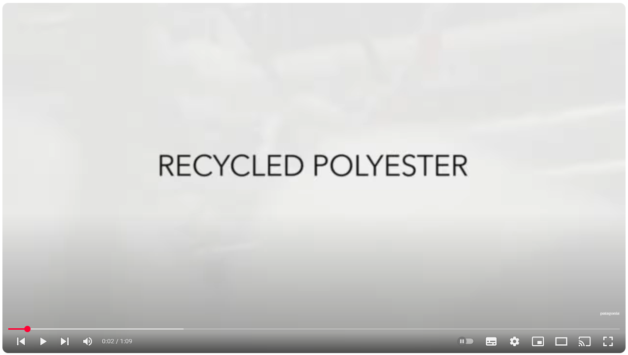
In the End: Simply apply these Principles!

Slide 39
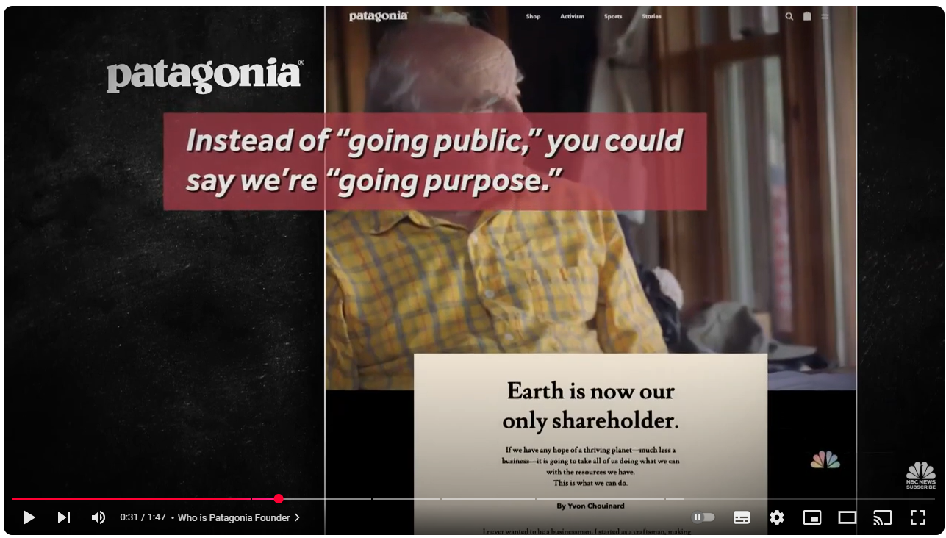
In the End: Simply apply these Principles!
Notes:
2022 ~ 100 Mio $ profit
Columbia sportswear: 223 in 2024

Slide 40
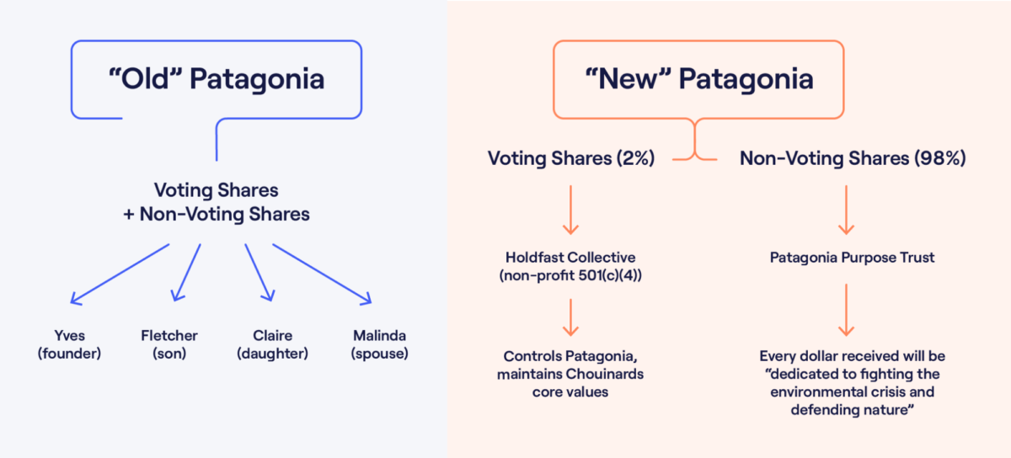
In the End: Simply apply these Principles!

Slide 41
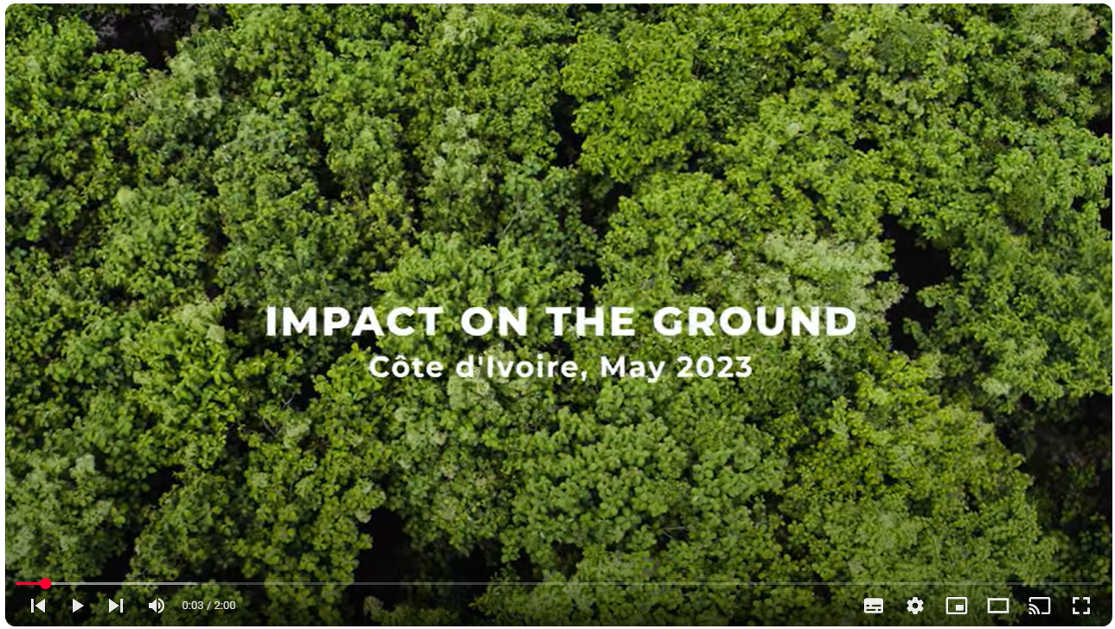
In the End: Simply apply these Principles!

Slide 42
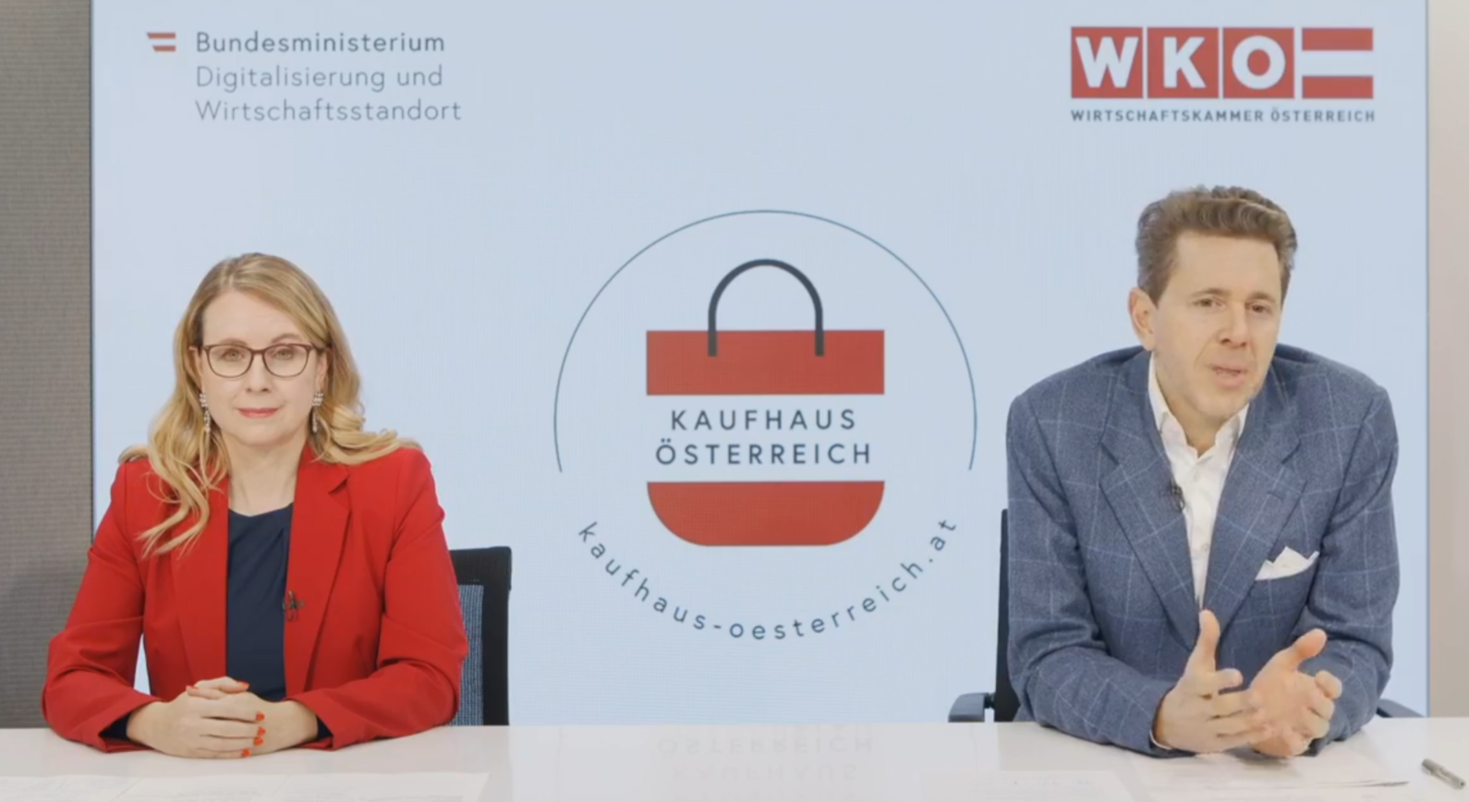
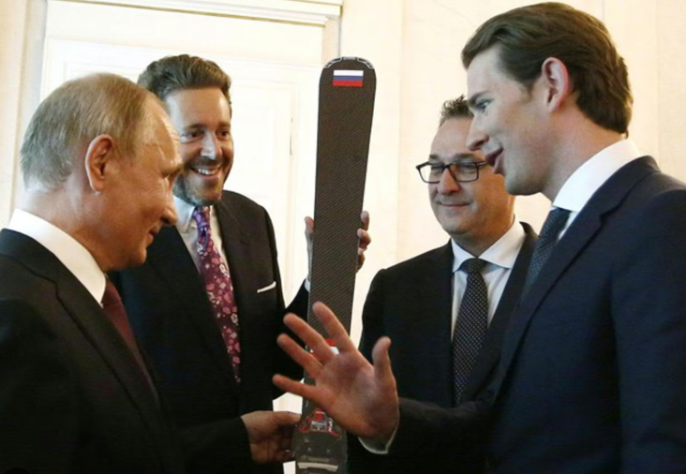
In the End: Simply apply these Principles?

Slide 43
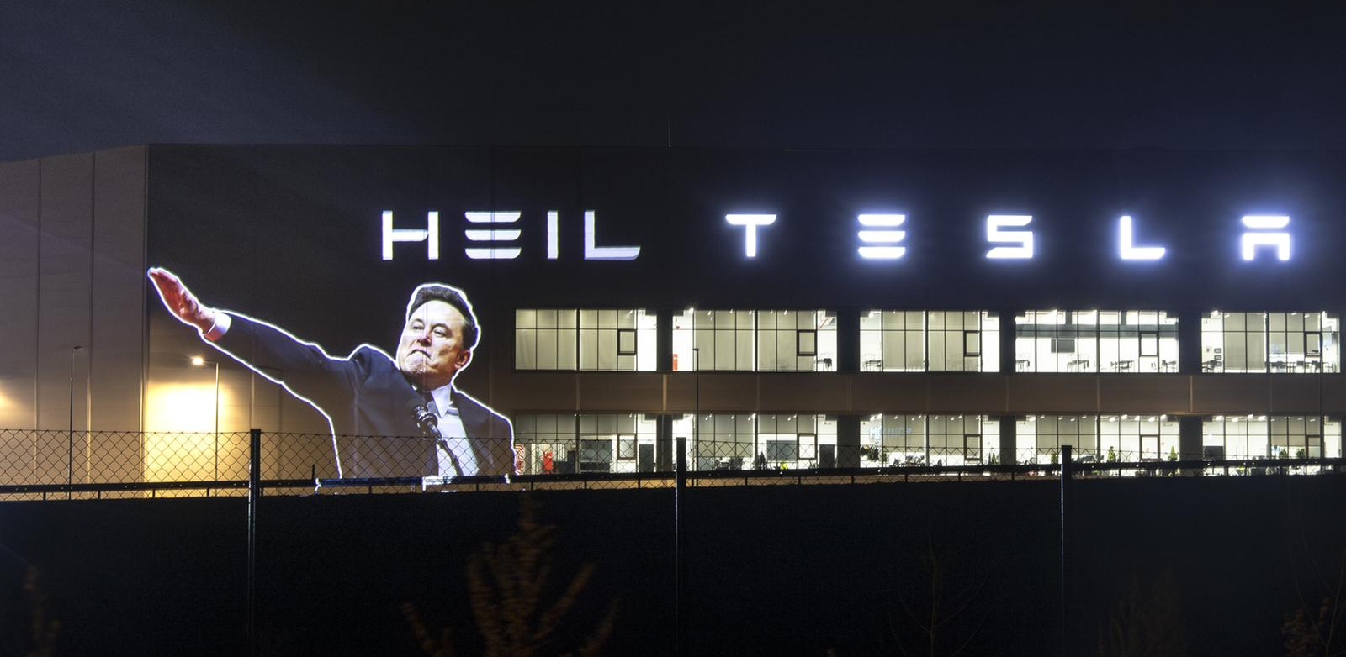
In the End: Simply apply these Principles?

Slide 44
Reviewing our performance so far
(Azote for Stockholm Resilience Centre, based on analysis in Richardson et al 2023; CC BY-NC-ND)

Slide 45
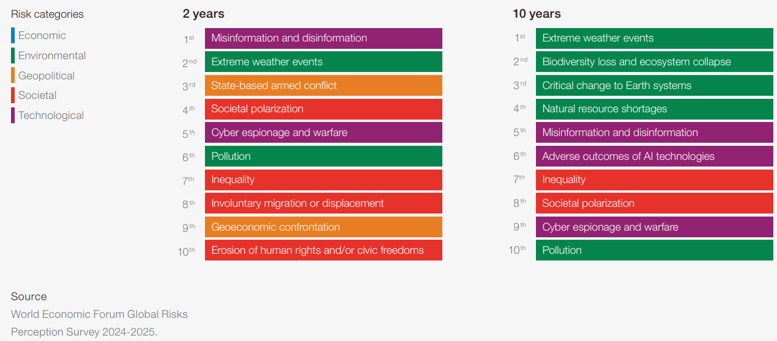
And looking ahead: The WEF-Perspective (2025)

Slide 46
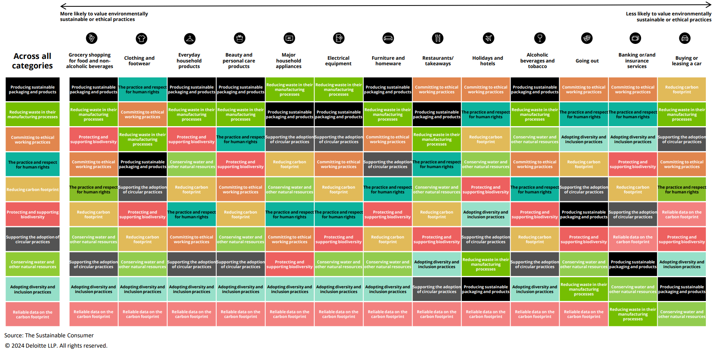
Why is it that hard?
Importance of environmentally sustainable and ethical values, by products and services

Slide 47
Can’t we manage our way out? Part I

Slide 48
Let’s start here and now:
What are your personal SMART commitments to sustainability and/or circularity this year?
From energy, waste over mobility to community engagement
Private vs. business
SMART?
Specific: Clearly define what needs to be achieved
Measurable: Include a way to track progress and success
Achievable: Is it realistic given available resources and constraints?
Relevant: Align it with your broader objectives or values
Time-bound: Give it a deadline or timeframe for completion

Slide 49
Let’s start here and now:
Like:
"I will reduce my meat consumption by eating vegetarian meals twice a week.“
"I will only buy second-hand clothing for the next three months.“
"I will use public transport instead of driving for this semester.“
"I will advocate for sustainability at my soccer club.“
…

Slide 50
Outlook

Slide 51
Wrap it up

Slide 52
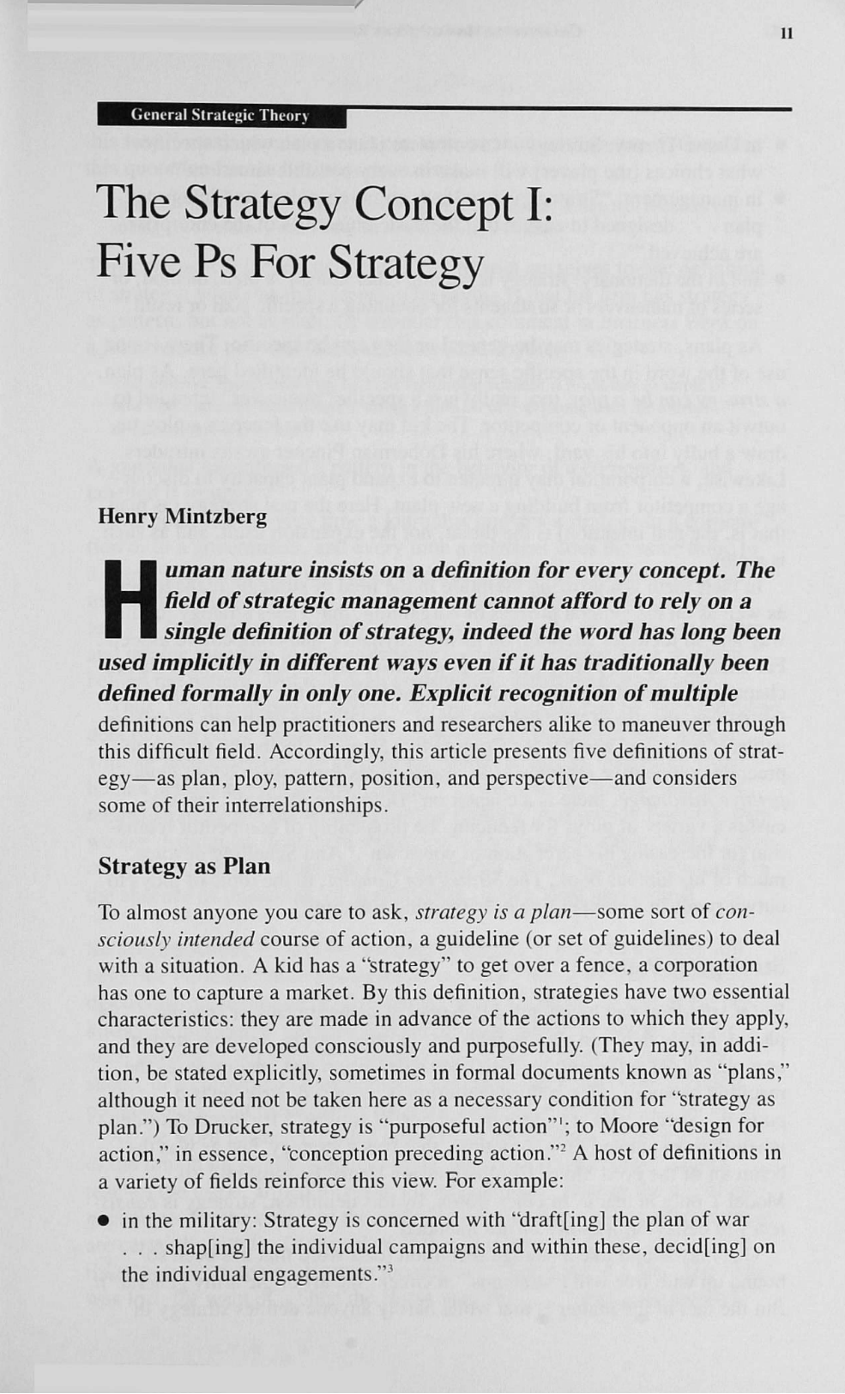
Till next Session:

Slide 53
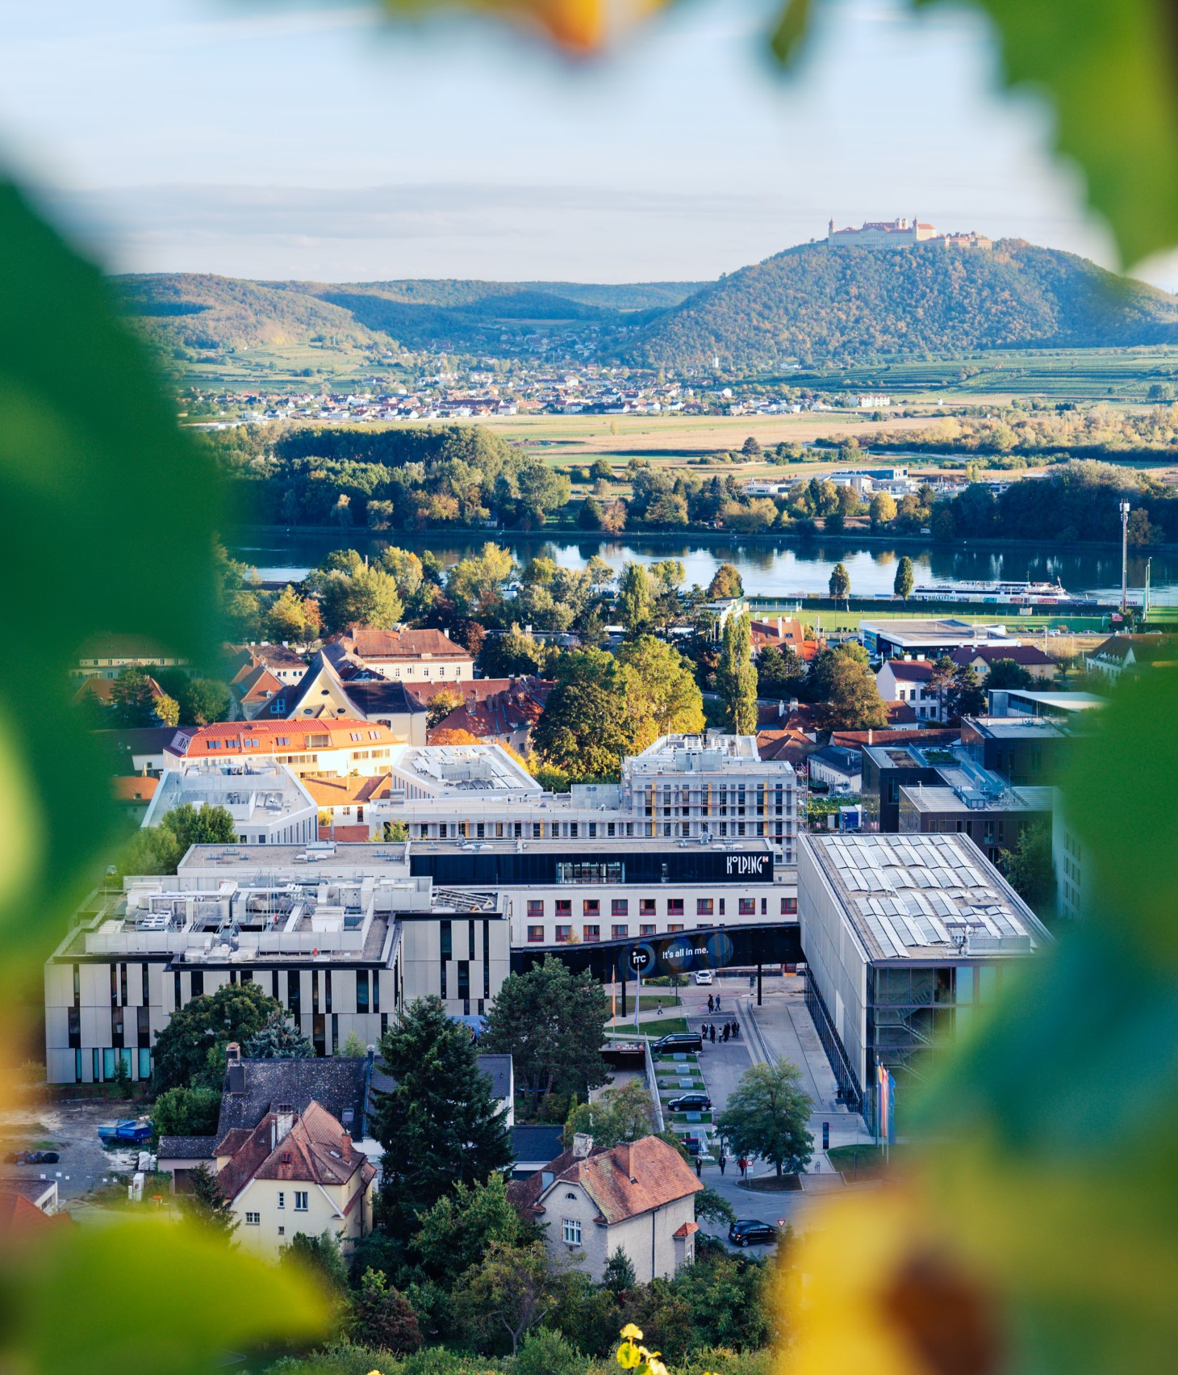

So long & cheerio!

